Slide 1
Creative Coding: why you should care

Slide 2
Who are we?
1
Let’s start with the basics

Slide 3
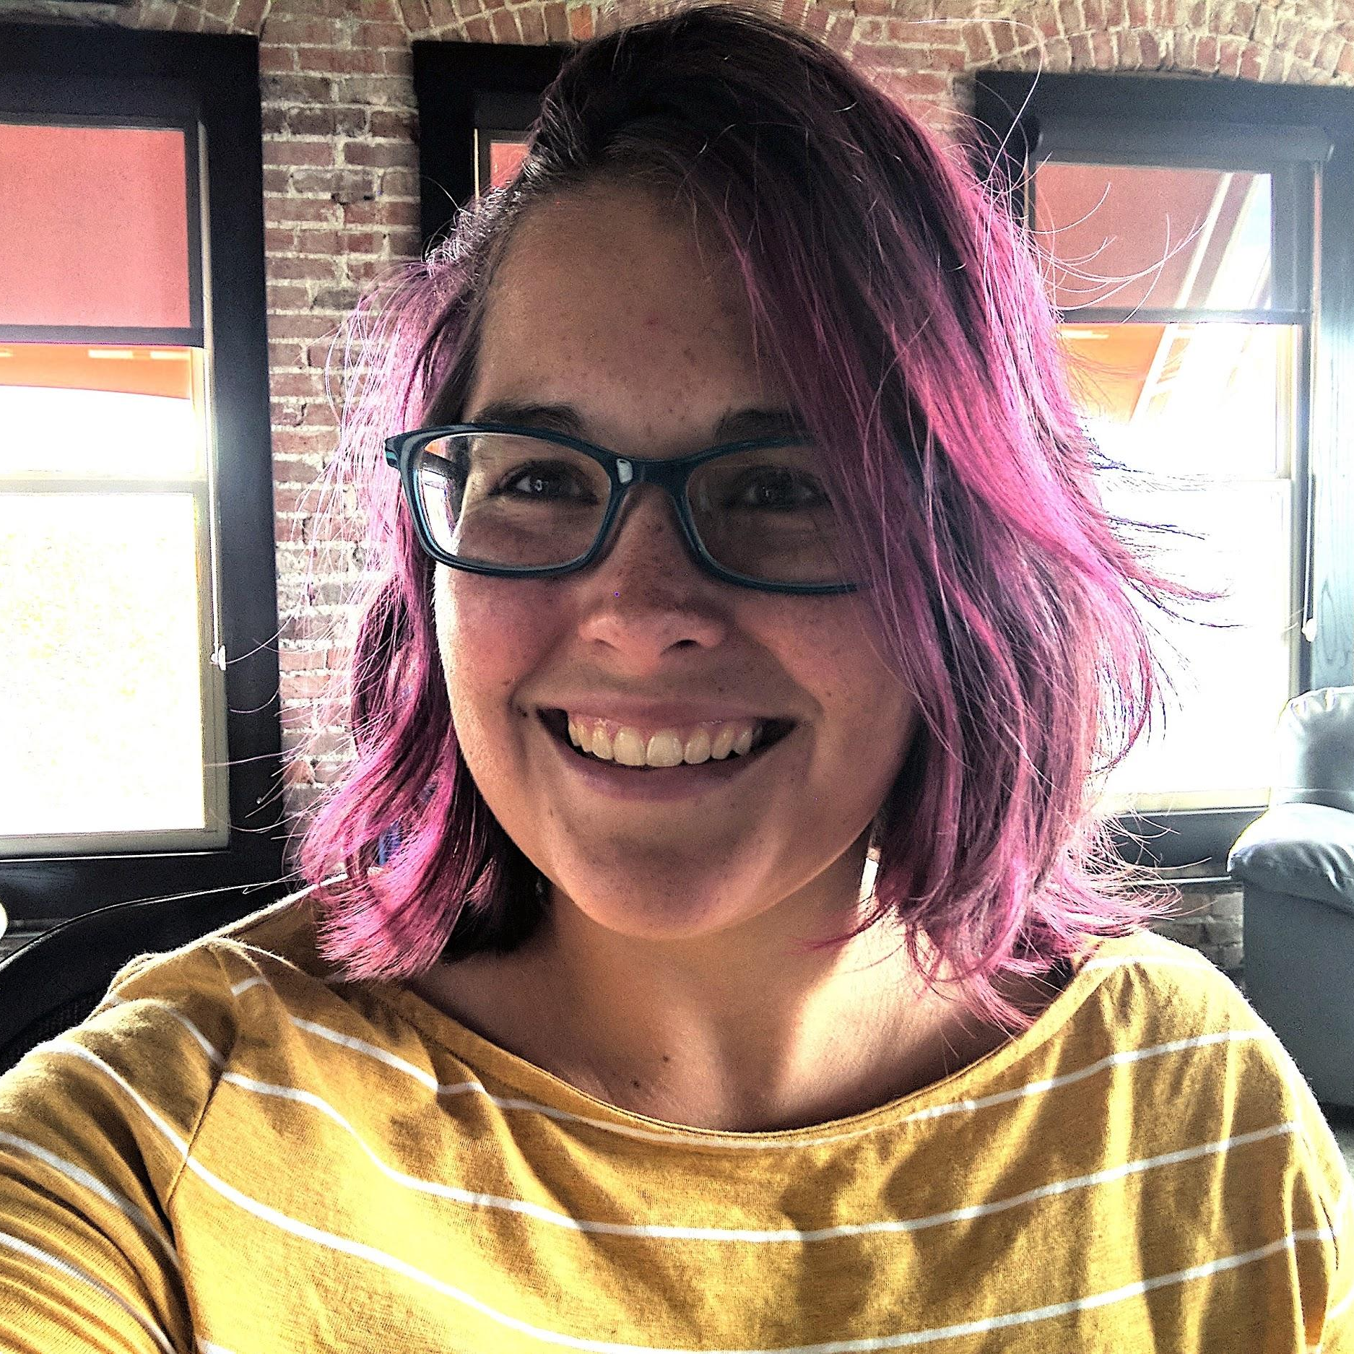
Hello!
I am Karen Fletcher
I am here because I love to give presentations. (No, really!)
You can find me at @knpfletcher on twitter

Slide 4
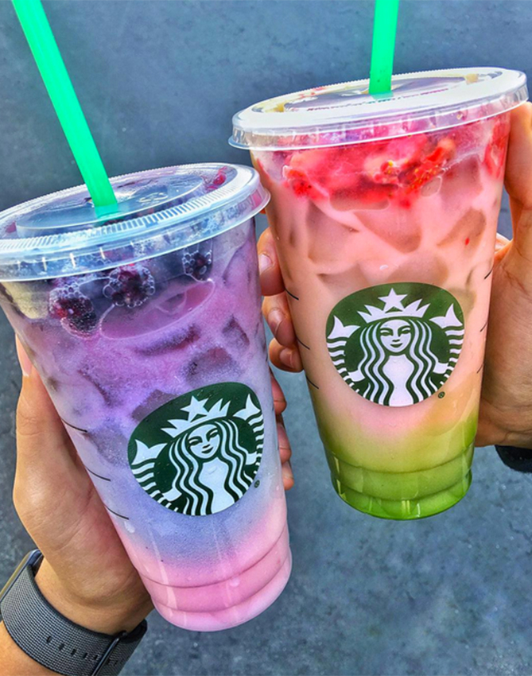
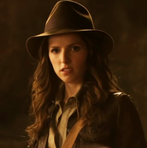
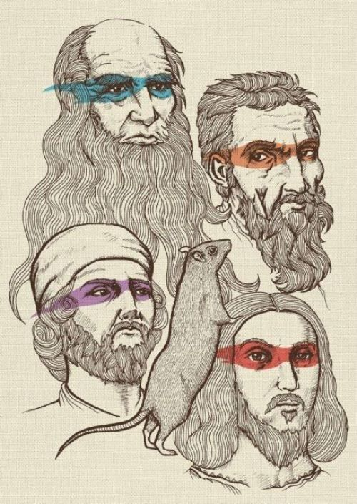

How did I get here?
Former barista
Anthropologist with an Archaeological bent
Art Historian with a distaste of Modern Art
Attended Arkansas Coding Academy in 2016
Notes:
ACA through UCA outreach center

Slide 5

Hello!
I am Chandler Gaines
I am here because I love making Power Points (Kinda true.)
You can find me at @chanandiler on instagram

Slide 6

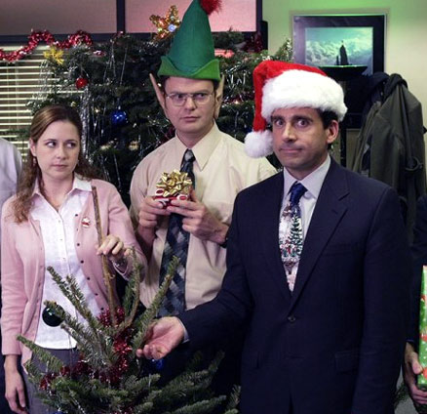
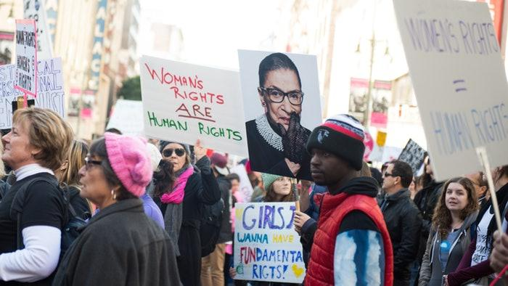
How did I get here?
Former event planner
Sociology major with Gender Studies minor
Jack of all trades, master of none
Attended Arkansas Coding Academy

Slide 7
When we were in high school...
Karen:
Conway High School
Never took a computer class beyond typing
Chandler:
Oden High School (Class size: 10)
The school had minimal funding
Keyboarding was the only computer class
Notes:
Segue into how many have taken a CS or Programming course?
History of computers, warehouses to hold them, punch cards, how long code took to compile and run, a painfully drawn out debugging process

Slide 8
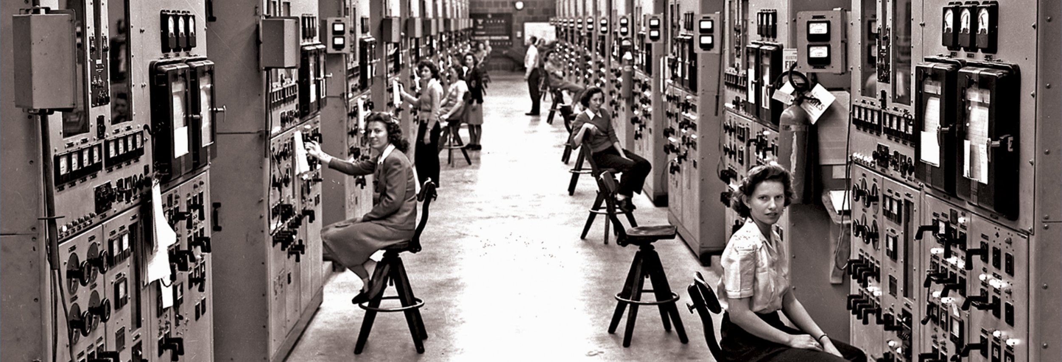
Awesome women in STEM:
2
Pioneers, legends, and why it matters

Slide 9
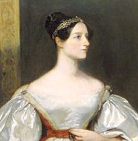
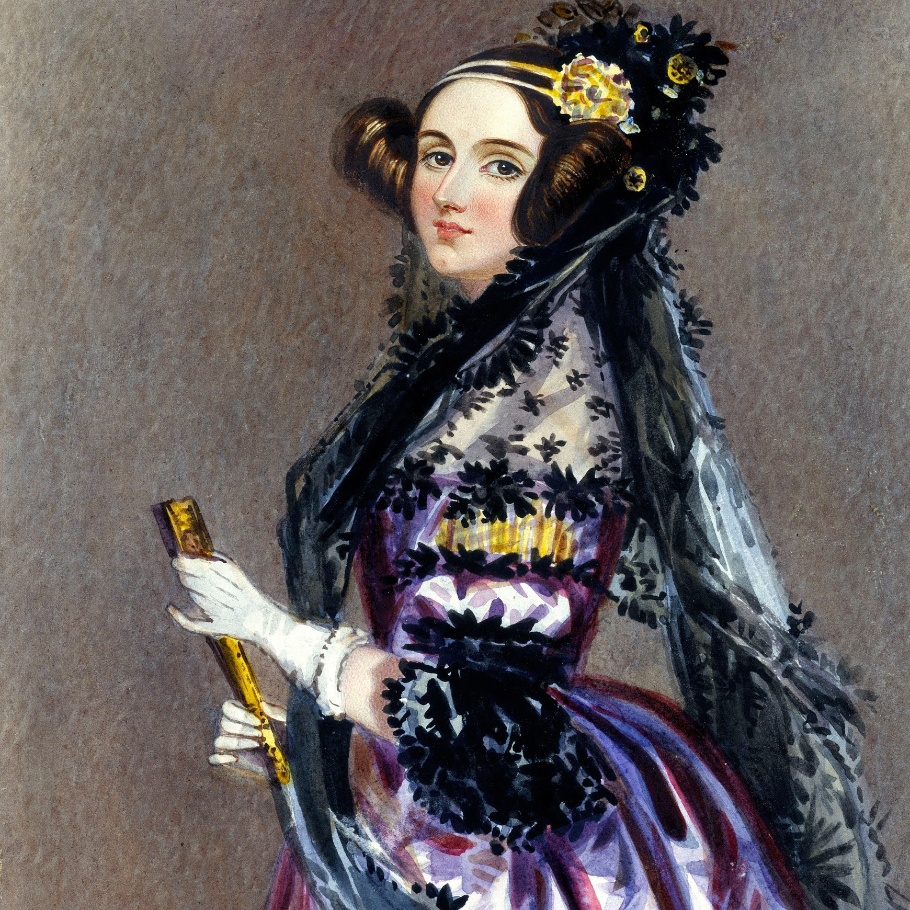
Ada Lovelace 1815 - 1852
Studied Math and Science
Analytical Engine
1842 - 1843: First computer programmer
Wrote an algorithm to translate an article about the Engine written in French by an Italian engineer
Others were focused purely on calculations
Notes:
After Napoleon, before Civil War (Manifest Destiny in US), California wasn’t part of US
Saw poetry in math - daughter of Lord Byron
Analytical Engine - mechanical computer

Slide 10
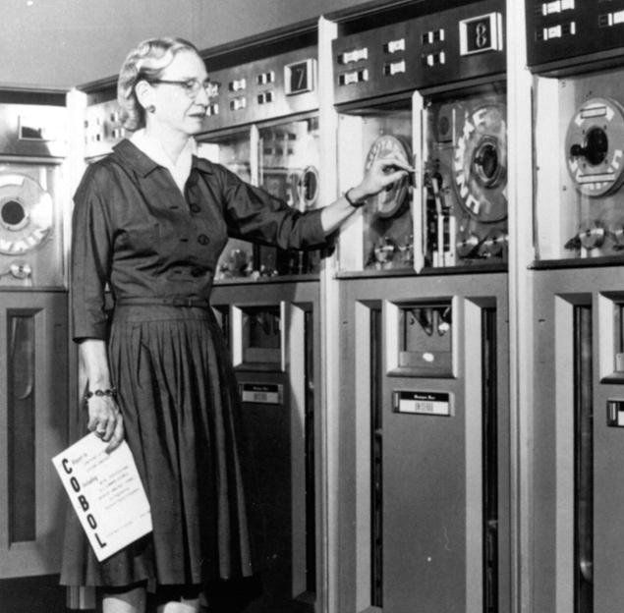
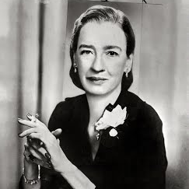
Grace Hopper 1906 - 1992
Rear Admiral in US Navy
1944 - wanted to make a programming language using English words
“computers didn't understand English”
Machine Independent programming languages -> COBOL
1970s - wanted any user to be able to access common databases located on the network
Notes:
“computers could only do arithmetic”
“I decided data processors ought to be able to write their programs in English, and the computers would translate them into machine code”
COBOL - common business oriented language - still used today, considered “legacy”
“Most dangerous phrase is, ‘it’s always been done that way’”

Slide 11
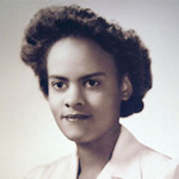
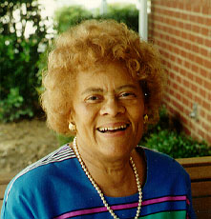
Evelyn Boyd Granville 1924 - present
One of the 1st black women to earn a PhD
Developed computer programs that were used in the Mercury Project and the Apollo Mission
Notes:
1st manned mission to space, moon landing

Slide 12
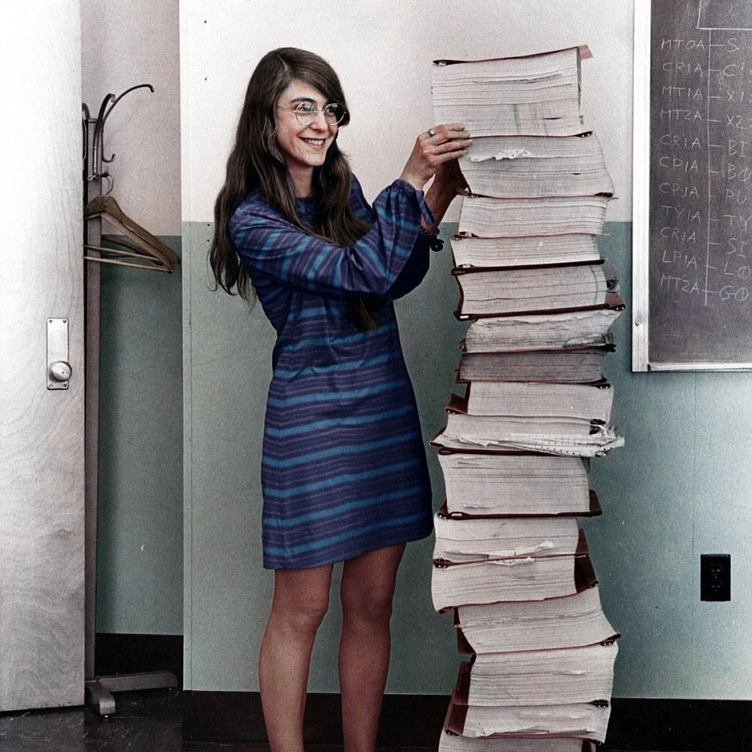
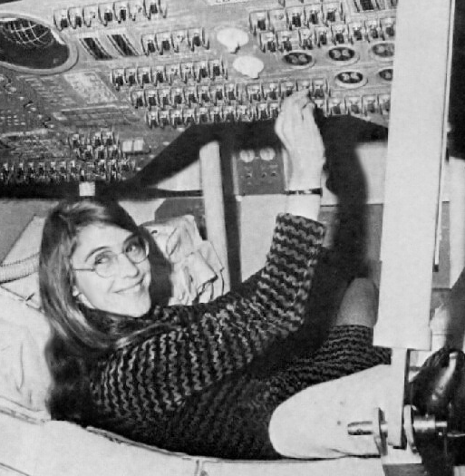
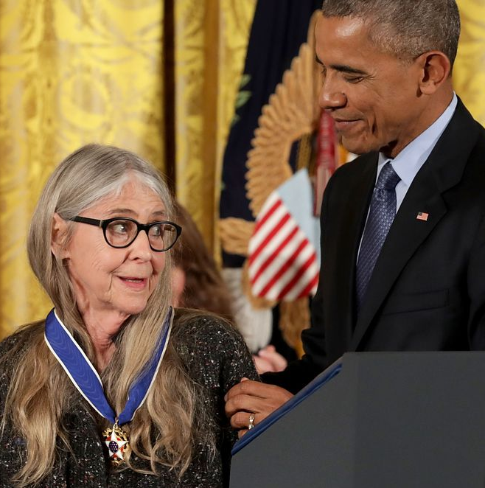
Margaret Hamilton
1936 - present
Created the building blocks of software engineering (a term she coined)
Developed on-board flight software for Apollo 11 mission to land on the Moon
Notes:
Standing with the source code for the Apollo Guidance Computer
The computer software was smart enough to recognize that it was being asked to perform more tasks than it should
sent out an alarm, A complete set of recovery programs was incorporated into the software which eliminated lower priority tasks and re-establish the more important ones (i.e. landing on the moon when radar systems failed)

Slide 13
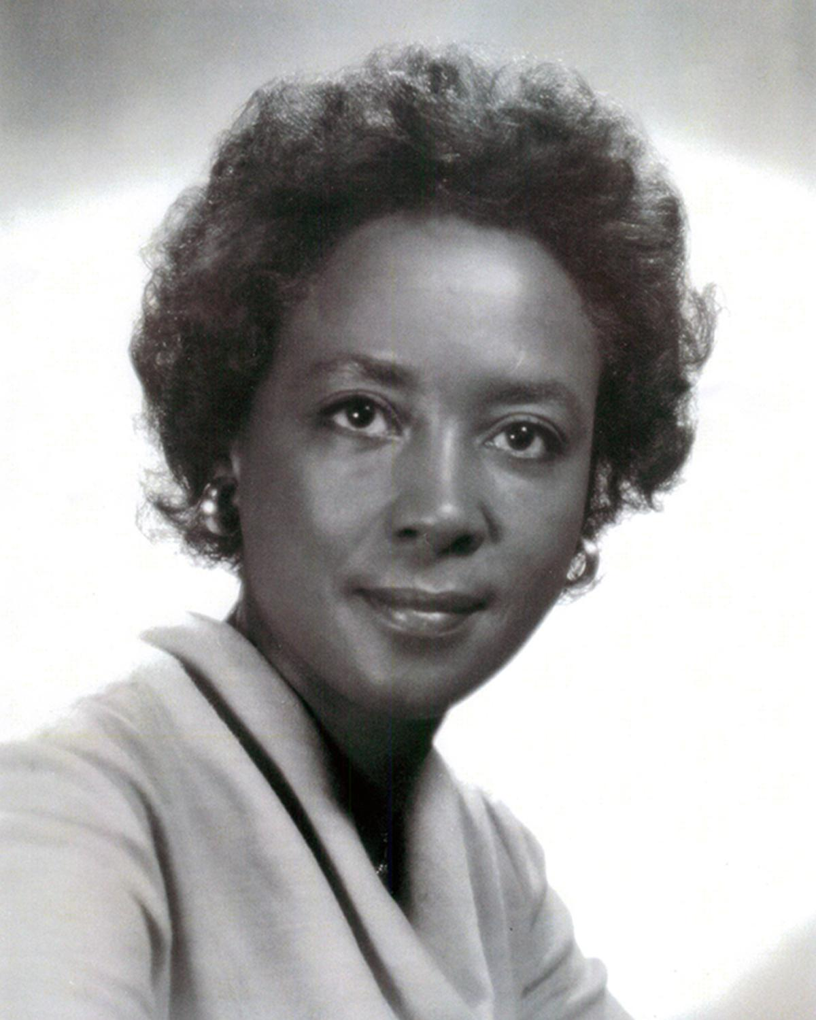
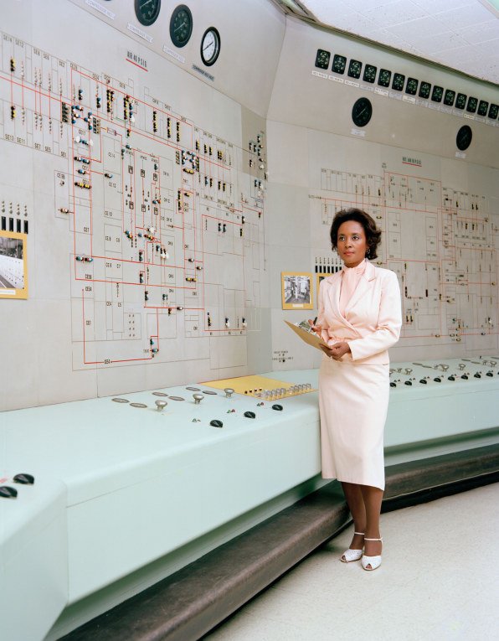
Annie Easley 1933 - 2011
1958 - Worked at NACA as a “human computer”
Worked for NASA on software for the high-energy / Centaur booster rocket
Used on Viking, Voyager, and Cassini
Variations still used today
Developed and implemented code for battery used in first hybrid cars
Notes:
Other human computers like Katherine Johnson, Dorothy Vaughan, Mary Jackson
helping America dominate aeronautics, space research, and computer technology

Slide 14
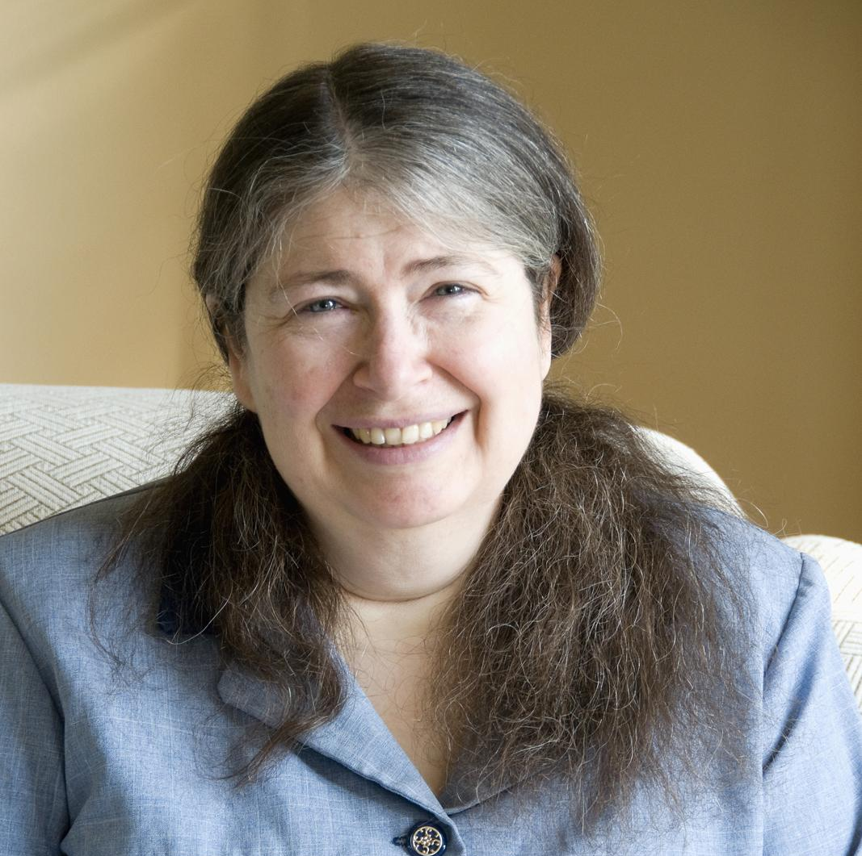
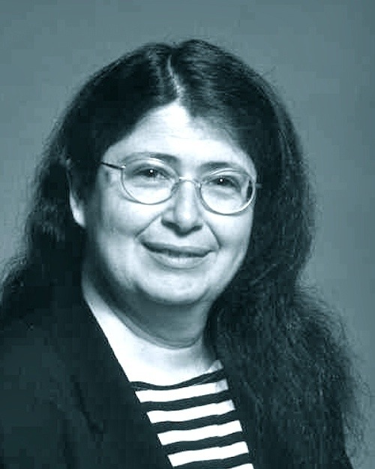
Radia Perlman 1951 - present
1984 - invented the protocols for routing network traffic
Basically invented the internet
Notes:
Other human computers like Katherine Johnson, Dorothy Vaughan, Mary Jackson
helping America dominate aeronautics, space research, and computer technology

Slide 15
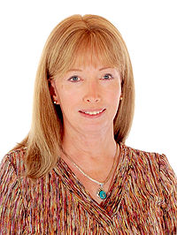
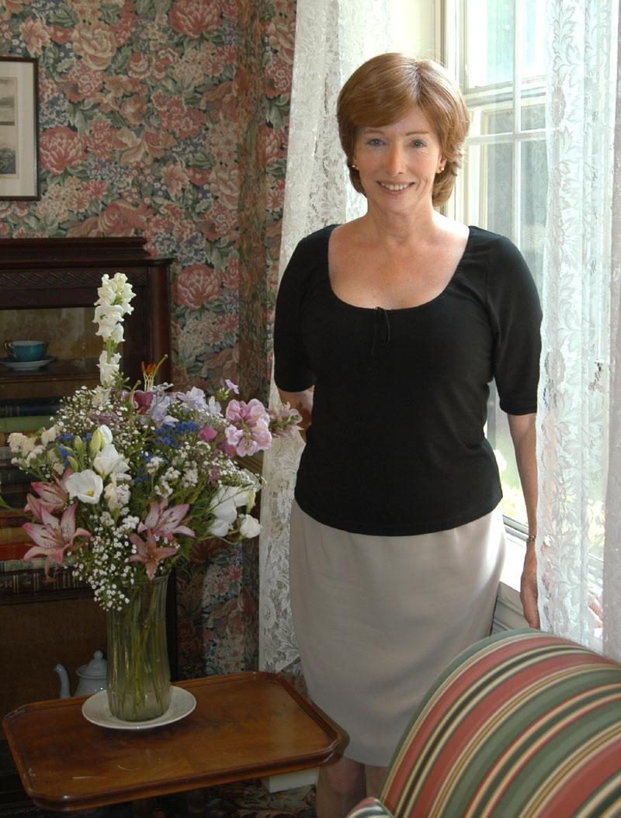
Lynn Conway 1938 - present
Pioneer of microelectronics chip design
Much of modern silicon chip design revolution is based on her work
Worked for IBM and Xerox
Invented a method for issuing multiple out-of-order instructions
Largely uncredited
Notes:
https://en.wikipedia.org/wiki/Lynn_Conway
Much of her research goes uncredited due to her transition in the late 1960s

Slide 16
Karen Sprack Jones
Mother of Search Engines
https://www.nytimes.com/2019/01/02/obituaries/karen-sparck-jones-overlooked.html?smid=fb-nytimes&amp;smtyp=cur
“Computing is too important to be left to men.”

Slide 17

So what gives?
Historically female
Becomes male dominated in late 1980s
Notes:
six female mathematicians who created programs for one of the world's first fully electronic general-purpose computers (ENIAC (Electronic Numerical Integrator And Computer))
Secret WWII project
“Men more interested in the hardware, machinery”
learned to program without programming language or tools, by the time they were finished, could run ballistics trajectory in mere seconds
Steve Jobs and Bill Gates emerge
Computer science degrees got more popular, and boys who had been tinkering with computer hardware looked like better candidates to computer science departments than girls who liked math because they’d already been tinkering - Virginia Tech Professor

Slide 18
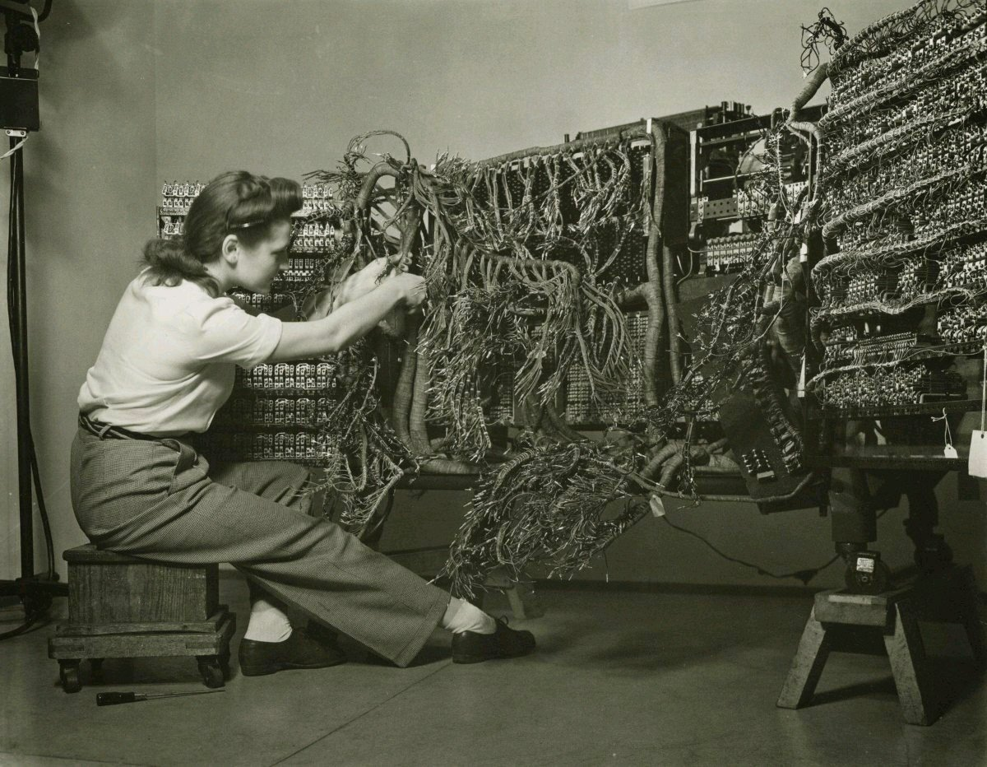
The Situation
3
How it happened and where to go from here
Notes:
Engineer installing an IBM computer in 1958

Slide 19
In 1984 the percentage of women in computer science flattened, then plunged
“Computers are for boys”
Marketed almost exclusively to men and boys
Personal computers become common in U.S. homes
Primarily for games and simple word processing
Notes:
In the 1990s, researcher Jane Margolis interviewed hundreds of computer science students at Carnegie Mellon University, which had one of the top programs in the country. She found that families were much more likely to buy computers for boys than for girls — even when their girls were really interested in computers. This was a big deal when those kids got to college. As personal computers became more common, computer science professors increasingly assumed that their students had grown up playing with computers at home.
Patricia Ordóñez didn't have a computer at home, but she was a math wiz in school.
"My teacher realized I was really good at solving problems, so she pulled me and this other boy out to do special math," she says. "We did math instead of recess!"
So when Ordóñez got to Johns Hopkins University in the '80s, she figured she would study computer science or electrical engineering. Then she took her first intro class — and found that most of her male classmates were way ahead of her because they'd grown up playing with computers.
In the '70s, that never would have happened: Professors in intro classes assumed their students came in with no experience. But by the '80s, that had changed.

Slide 20
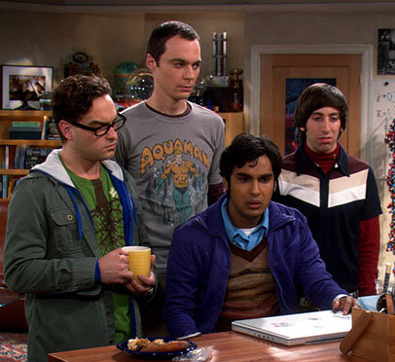

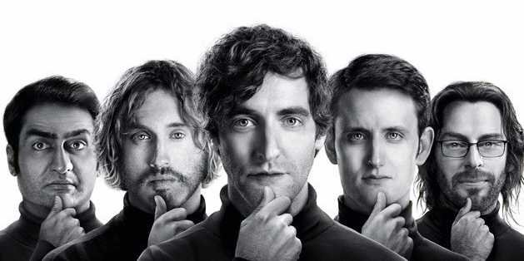
“Computers are for boys”
Movies in the 80s like War Games and Weird Science, Revenge of the Nerds almost all feature the awkward geek boy genius who uses tech savvy to triumph over adversity and win the girl.

Slide 21
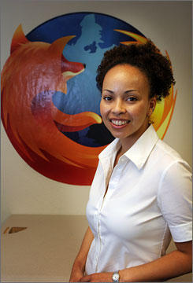

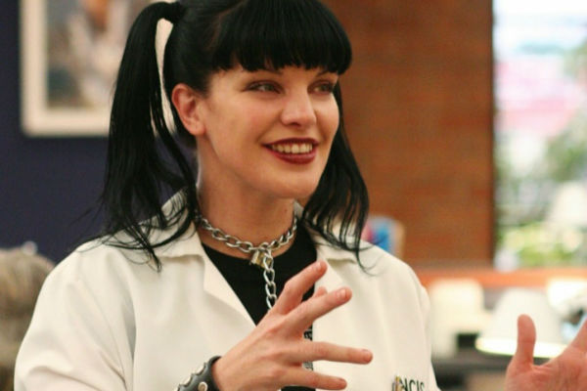
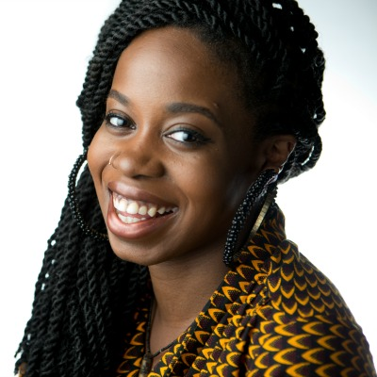
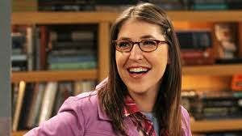
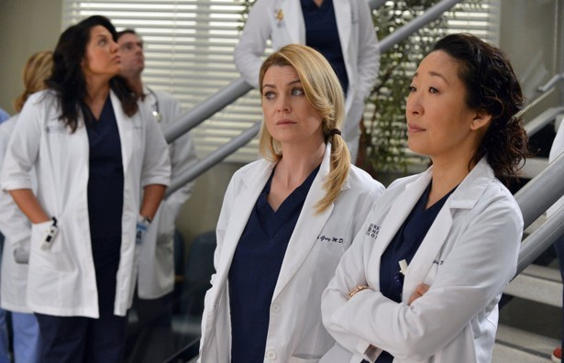
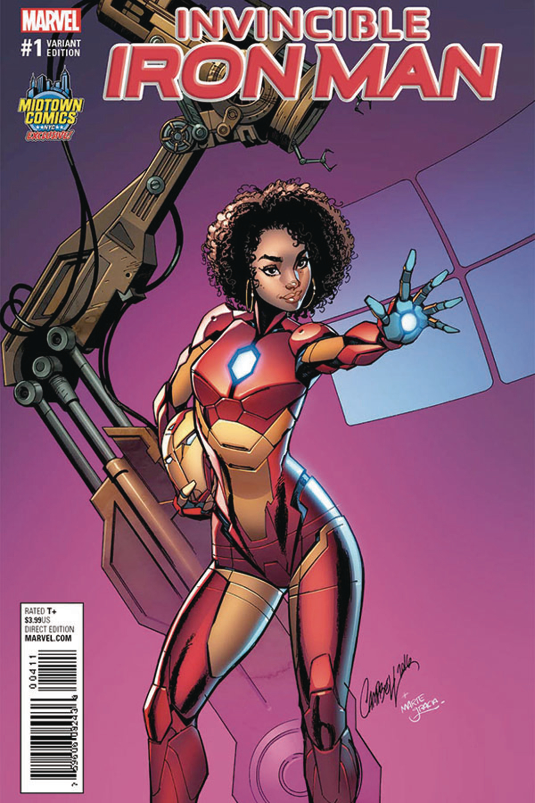
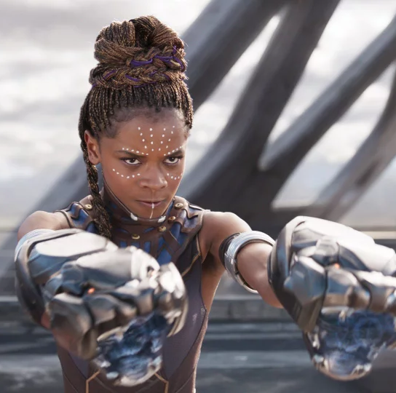
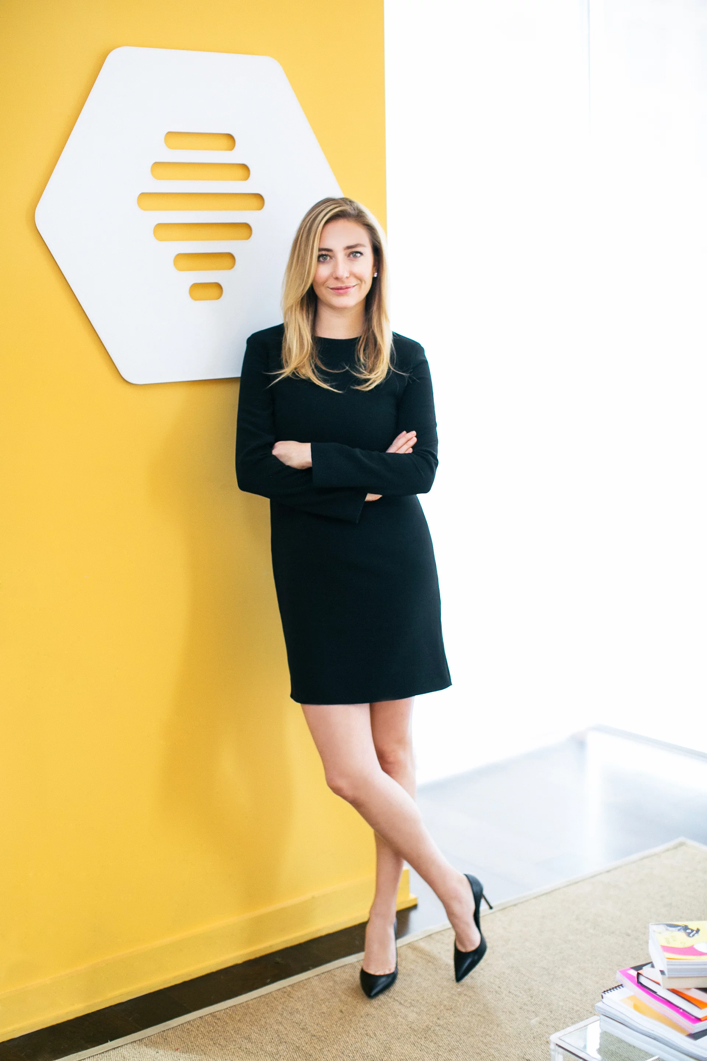
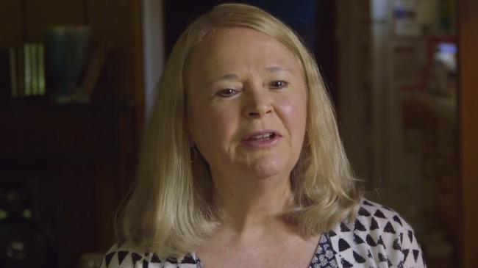
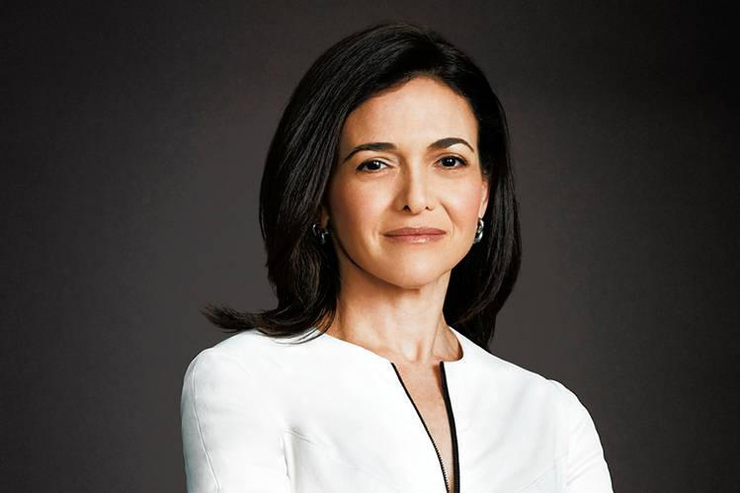
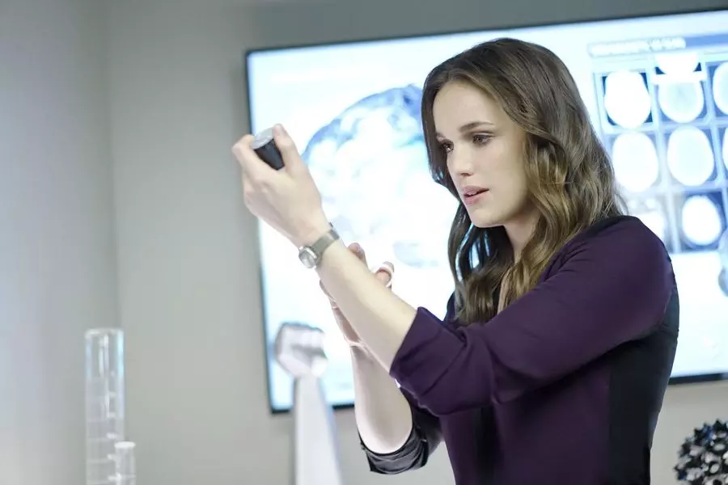
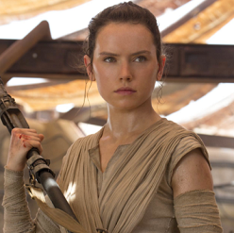
So what now?
Notes:
Whitney Wolfe is awesome. She helped found Tinder, ended up getting smeared by the tech community after an ugly breakup with another founder. Used the experience to lay the groundwork for Bumble and it’s unique UX. Sheryl Kara Sandberg is an American technology executive, activist, and author. She is the chief operating officer (COO) of Facebook and founder of Leanin.org (also known as the Lean In Foundation). Donna Bailey created Centipede (the arcade game) and was the only woman in her division at Atari, she was still the only woman in her division when she left. http://blerds.atlantablackstar.com/2015/02/24/10-exceptional-black-women-who-are-changing-the-face-of-tech/ Window Snyder
She is the security and privacy product manager of Apple. Snyder is an expert on cryptography and has worked at Mozilla, and Microsoft.
Kelechi Anyadiegwu
Anyadiegwu is the founder of Zuvaa. This site is an international Web-based marketplace for African style. Zuvaa also offers meaningful cultural stories about each designer. Anyadiegwu is a social media expert. She has worked with EA Sports, the Microelectromechanical Systems Sensors Trade Association and many others.

Slide 22
It’s your turn
You know, if you want to.
CodeCombat
SpriteBox
Notes:
Really what this means is a tremendous opportunity
Projected need of 1 million workers: Companies need more programmers, computer scientists, the demand is only growing
AND THEY NEED WOMEN TO SURVIVE
-diversity!!

Slide 23
The Finale
4
You’re almost free from our presentation!

Slide 24
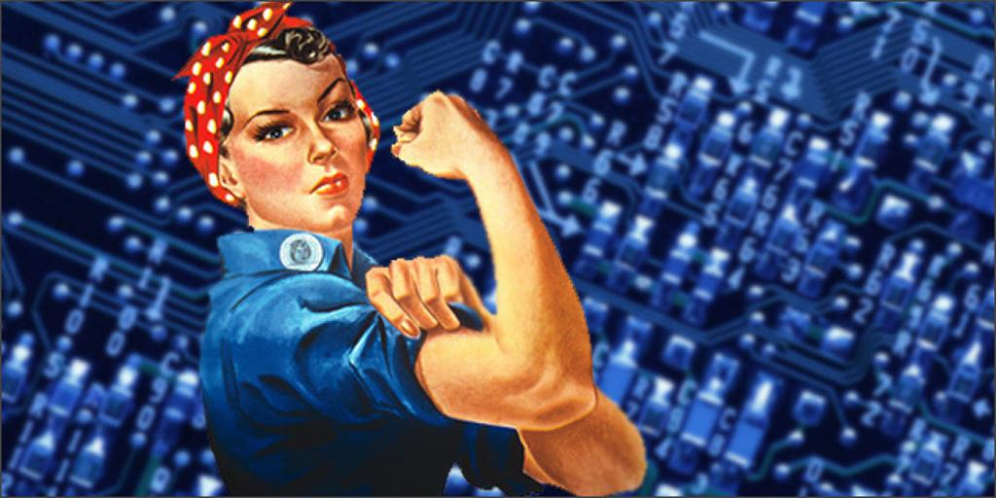
Support each other!
Girl Develop It
Girls/Women Who Code
Black Girls Code
Embrace mistakes!
Make rad things!
Learn a lot! Work hard!
Have fun!
Notes:
Support each other - great community of women, just have an extra hair tie
Stay hungry

Slide 25
FREE Resources
Hour of Code modules
SoloLearn apps
Code Academy
Free Code Camp
MIT OpenCourseware
CodeNewbie community
Base CS podcast

Slide 26


Thanks!
Any questions? Feel free to reach out to us!
chandler.gaines@metova.com @chanandiler on Instagram karen.fletcher@metova.com @knpfletcher on Twitter

